Slide 1
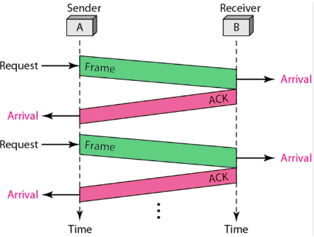

Stop & Wait Protocol:
Using Python

Slide 2
What is Stop & wait protocol :
It is a simple and fundamental data link layer as well as transport layer protocol used in computer networks to ensure reliable data transmission between a sender and a receiver.
It is based on the concept of sending one data packet at a time and waiting for an acknowledgment (ACK) before sending the next packet.

Slide 3
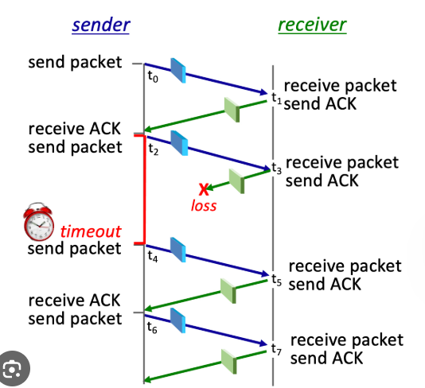
WORKFLOW :
Sender Side:
The sender sends one data packet to the receiver.
After sending the packet, the sender stops and waits for an ACK from the receiver.
If the sender receives the ACK, it proceeds to send the next packet.
If the sender does not receive the ACK within a specified time, it retransmits the same packet.

Slide 4
WORKFLOW :
Receiver Side:
The receiver receives the packet from the sender.
If the packet is received correctly, the receiver sends an ACK to the sender.
If the packet is lost or contains errors, the receiver does not send an ACK, prompting the sender to retransmit the packet.

Slide 5
Advantages
Disadvantages
Low Efficiency & High Latency
Limited Throughput
Not Suitable for Large Networks
Simplicity
Error Control
Flow Control
Reliable Delivery

Slide 6
Thank you!

